Slide 1
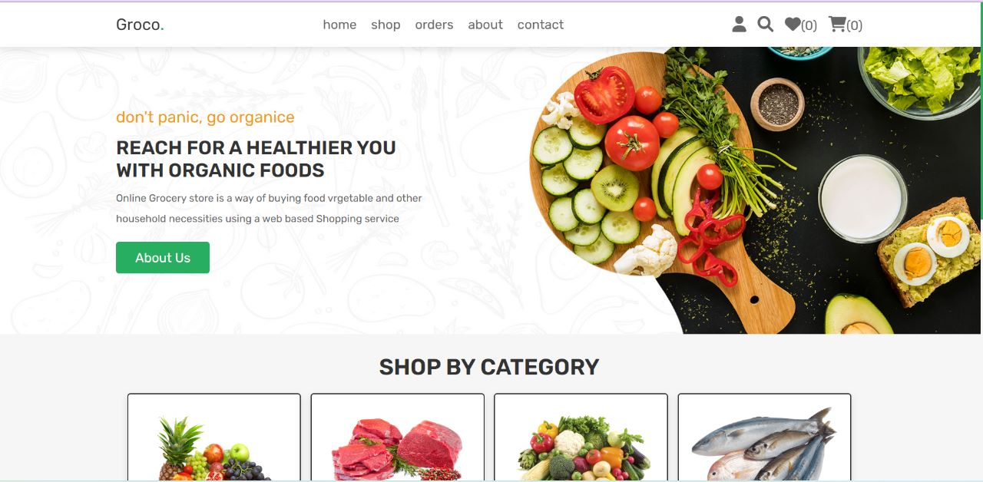
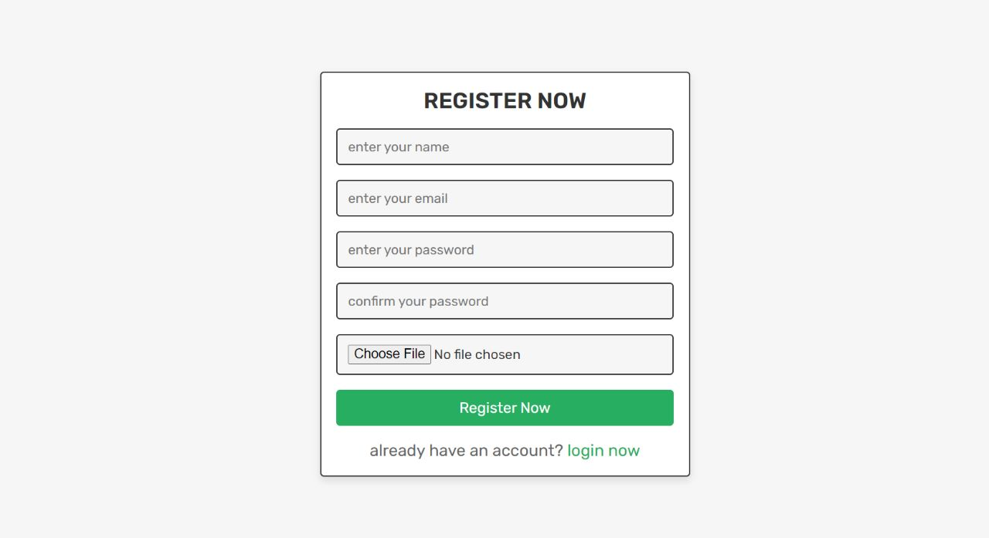
GSM
GROCERY SHOP MANAGEMENT SYSTEM
Bhumika Patidar, Amar Chouhan , Ashutosh Mandloi , Ayush Sahu
Introduction
Result
Conclusion
The Grocery Shop Management System has been developed to override the problems prevailing in the practicing manual system.
This software is supported to eliminate and in some cases reduce the hardships faced by this existing system.
The application is reduced as much as possible to avoid errors while entering the data. It also provides error message while entering invalid data. No format knowledge is needed for the user to use this system. Thus by this all it proves It is user-friendly. Grocery Shop Management System , as described above, can lead to error free, secure, reliable and fast management system.
The project is only a humble venture to satisfy the needs to manage their project work. Several user friendly coding have also adopted. This package shall prove to be a powerful package in satisfying all the requirements of the school. The objective of software planning is to provide a frame work that enables the manager to make reasonable estimates made within a limited time frame at the beggning of the software project and should be updated regularly as the project progresses.
Reference
1. Bhosale , Sachin & Sharma, Yogeshkumar & Chogule, Miss & Jagdishprasad, Shri &Tibrewala, Jhabarmal. (2021). ONLINE GROCERY MANAGEMENT SYSTEM.
2. "Tennessee History for Kids". Tnhistoryforkids.org. Documentation from the original happening 2015-02-23. Retrieved
3. Understanding Nourishment: Values and Groundwork, Amy Chocolate, ISBN 978-0538734981, 2013 . Definition of delicatessen - Merriam-Webster's Student Dictionary". Wordcentral.com. 2012-09-Retrieved 2015-03-06
4. "Online grocery growth tests U.S. retail agility". The City Wire. Archived from the original on 2014-06-27. Retrieved 28
Objective
The main objective of the project in Grocery Shop Management System is to manage the details of Customer , Product , product company, product type, supplier. It manages all the information about customer , Stock, Supplier, Customer. The project is totally built at administrative end and thus only the administrator is guaranteed the access. The purpose is to build an application program to reduce the manual work for managing the customer, product, stock, product company. It tracks all details about the product company, product type, supplier.
Materials & Method
Model View Controller or MVC as it is popularly called as a software design pattern for developing web application. A Model view controller is made up of three parts: MODEL: The lowest level of pattern which is responsible for maintaining data. VIEW: This is responsible for displaying all or a portion of the data to the user. CONTROLLER: Software code that controls the interactions between the model and view.MVC is a popular as it isolates the application logic from the user interface layer and supports separation of concerns. Here the controller receives all requests for the application and then works with the model to prepare any data needed by the view.
Front end: HTML, CSS, JavaScript
Back end: PHP, MySQL
Contact
Bhumika Patidar - bhumikapatidar20272@acropolis.in
Amar Chouhan - amarchouhancs21@acropolis.in
Ashutosh Mandloi - ashutoshmandloics21@acropolis.in
Ayush sahu - ayushsahucs21@acropolis.in

